Slide 1


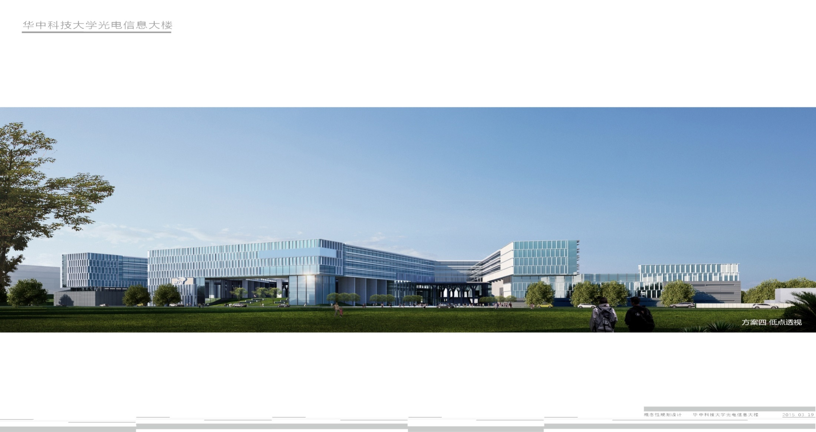
Paper sharing:Deep neural network enabled active metasurface embedded design
Speaker :Ying Jie

Slide 2

Background Knowledge
1. Metasurface
2. DBR
3.PCM

Slide 3
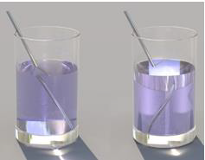
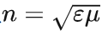
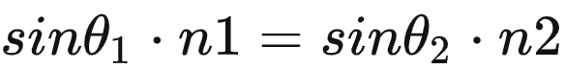
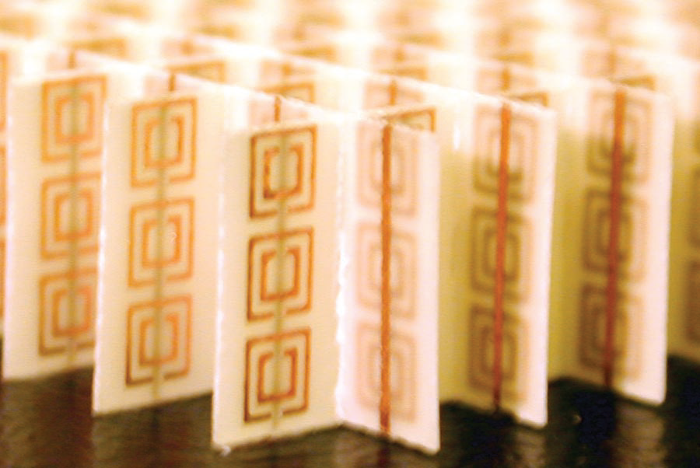
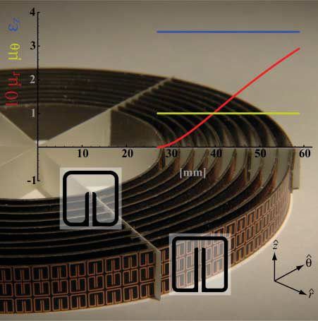
The buzzword “Metasurface” around in academic circles

Slide 4
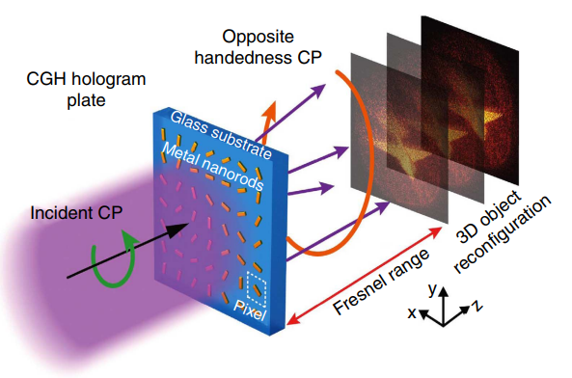
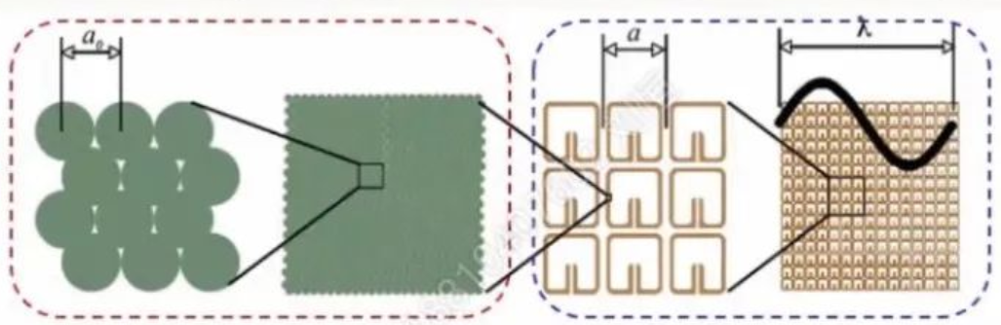
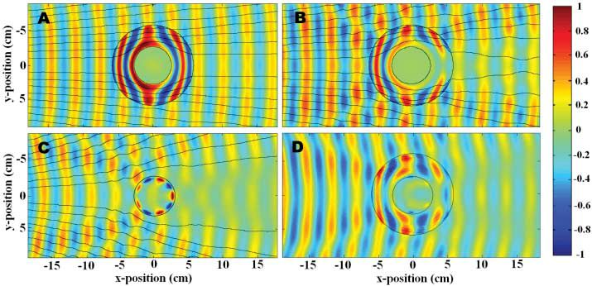
The buzzword “Metasurface” around in academic circles

Slide 5
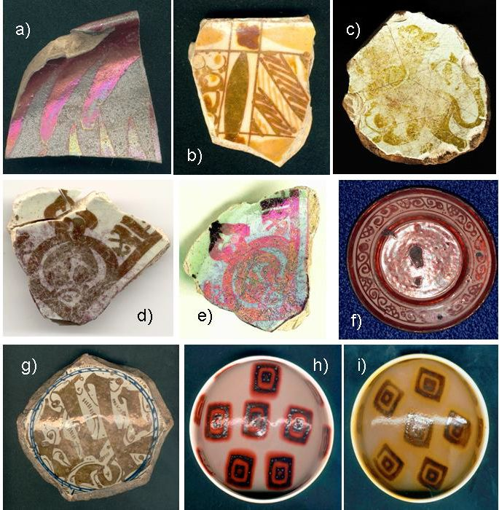
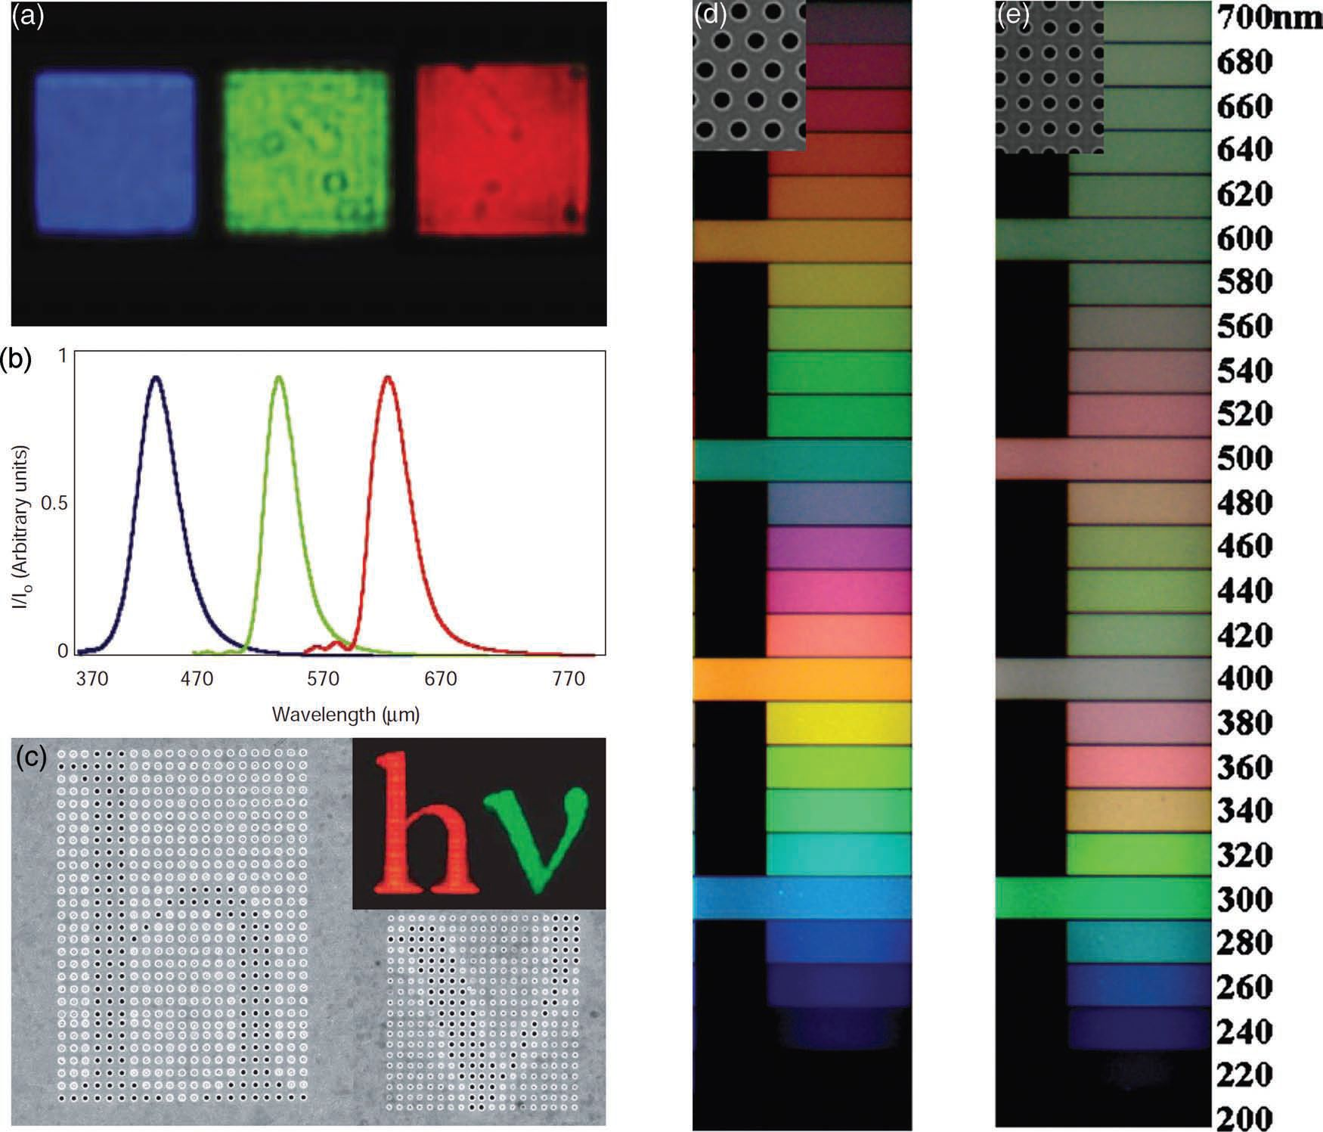
The buzzword “Metasurface” around in academic circles
Reflection, transmission, diffraction and resonant absorption

Slide 6
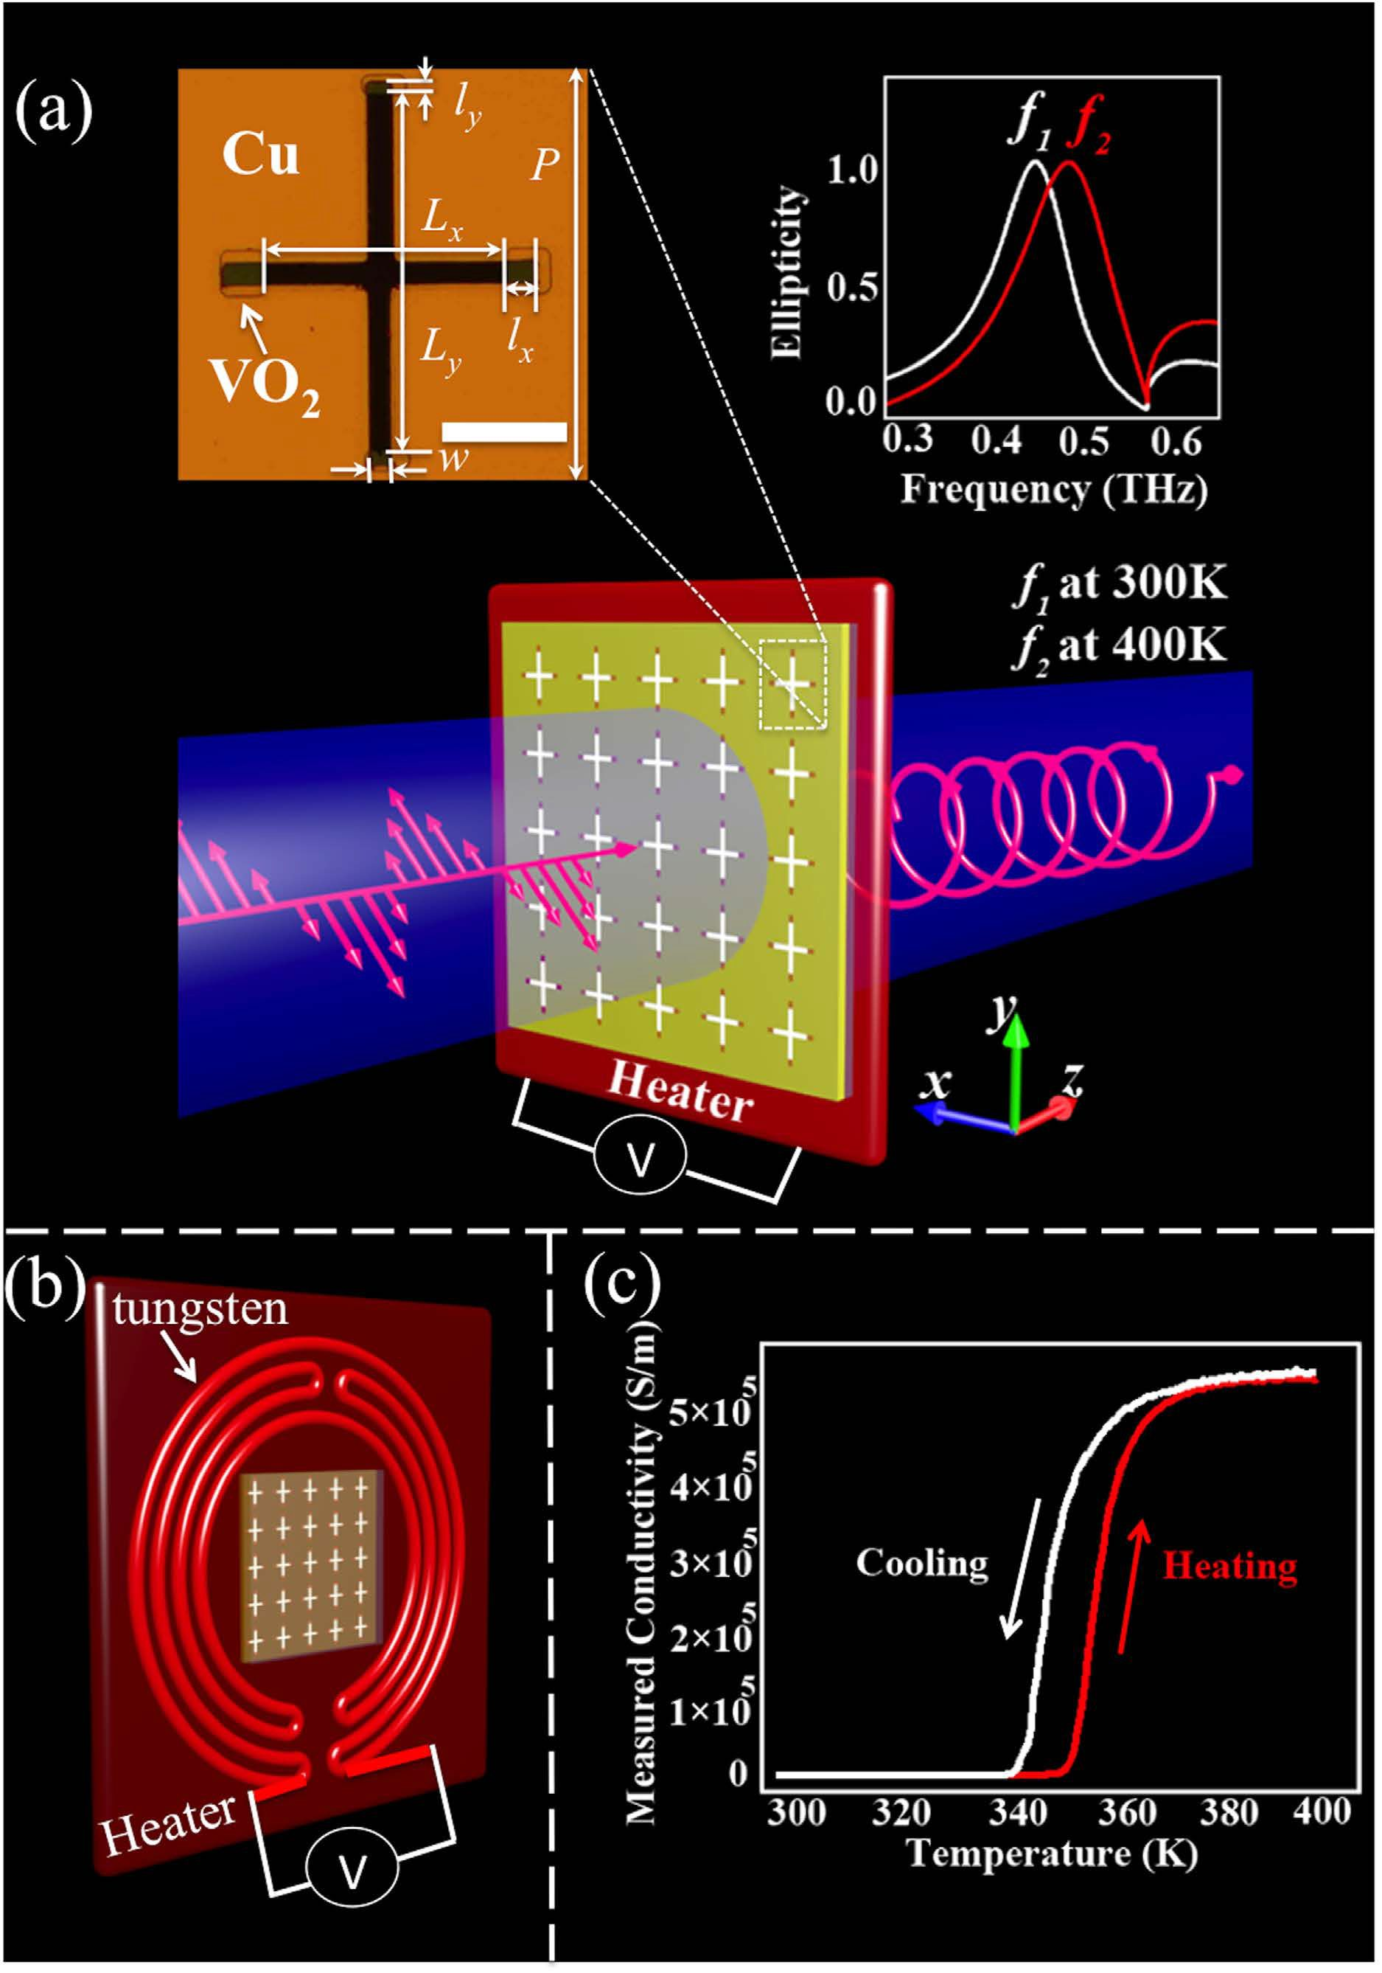
The buzzword “Metasurface” around in academic circles
For example, the figure on the right is a quarter-wave plate realized by using this type of material.
The copper metamaterial is regulated by the gain and loss of VO2’s metallicity.

Slide 7
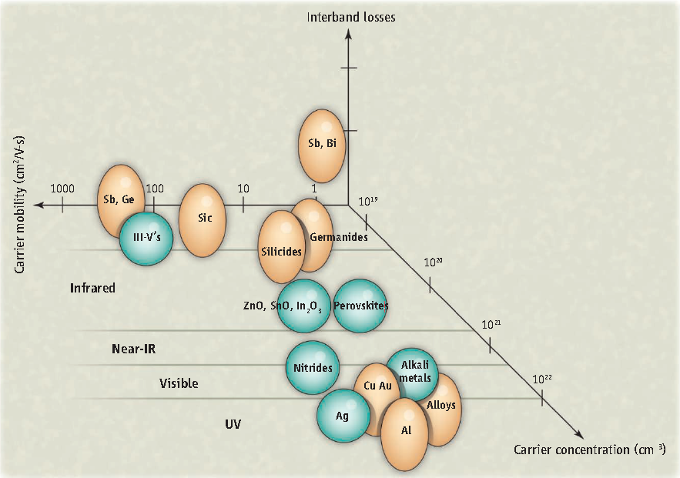
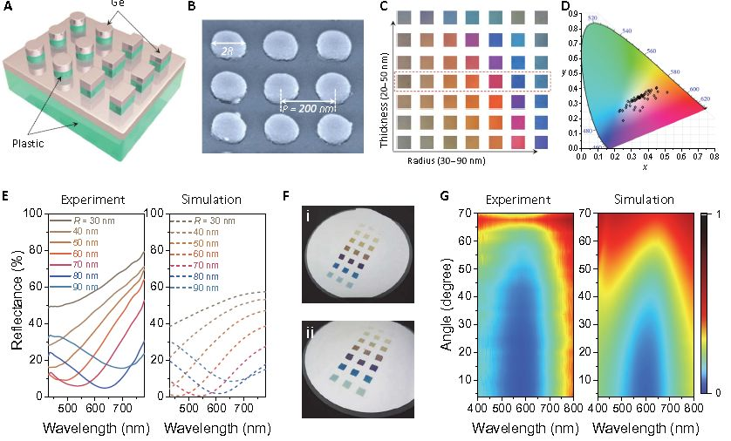
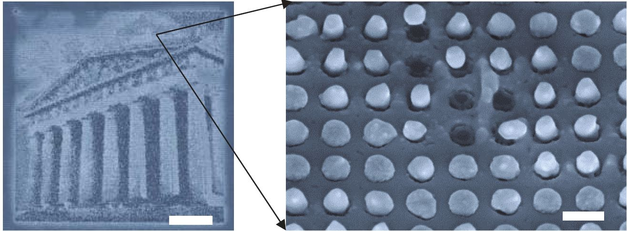
The buzzword “Metasurface” around in academic circles

Slide 8
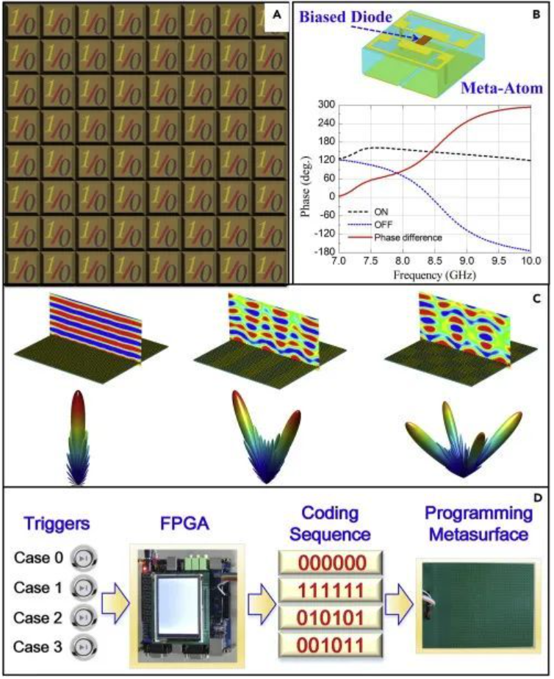
Metasurface and optoelectronic devices
Different codes allow information metamaterials to dynamically manipulate electromagnetic waves.
It can also realize the control of multiple dimensions of incident electromagnetic wave.

Slide 9
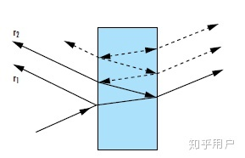
What’s the “DBR”(分布式布拉格反射器)?
The superposition of multiple layers of this material can form a DBR

Slide 10
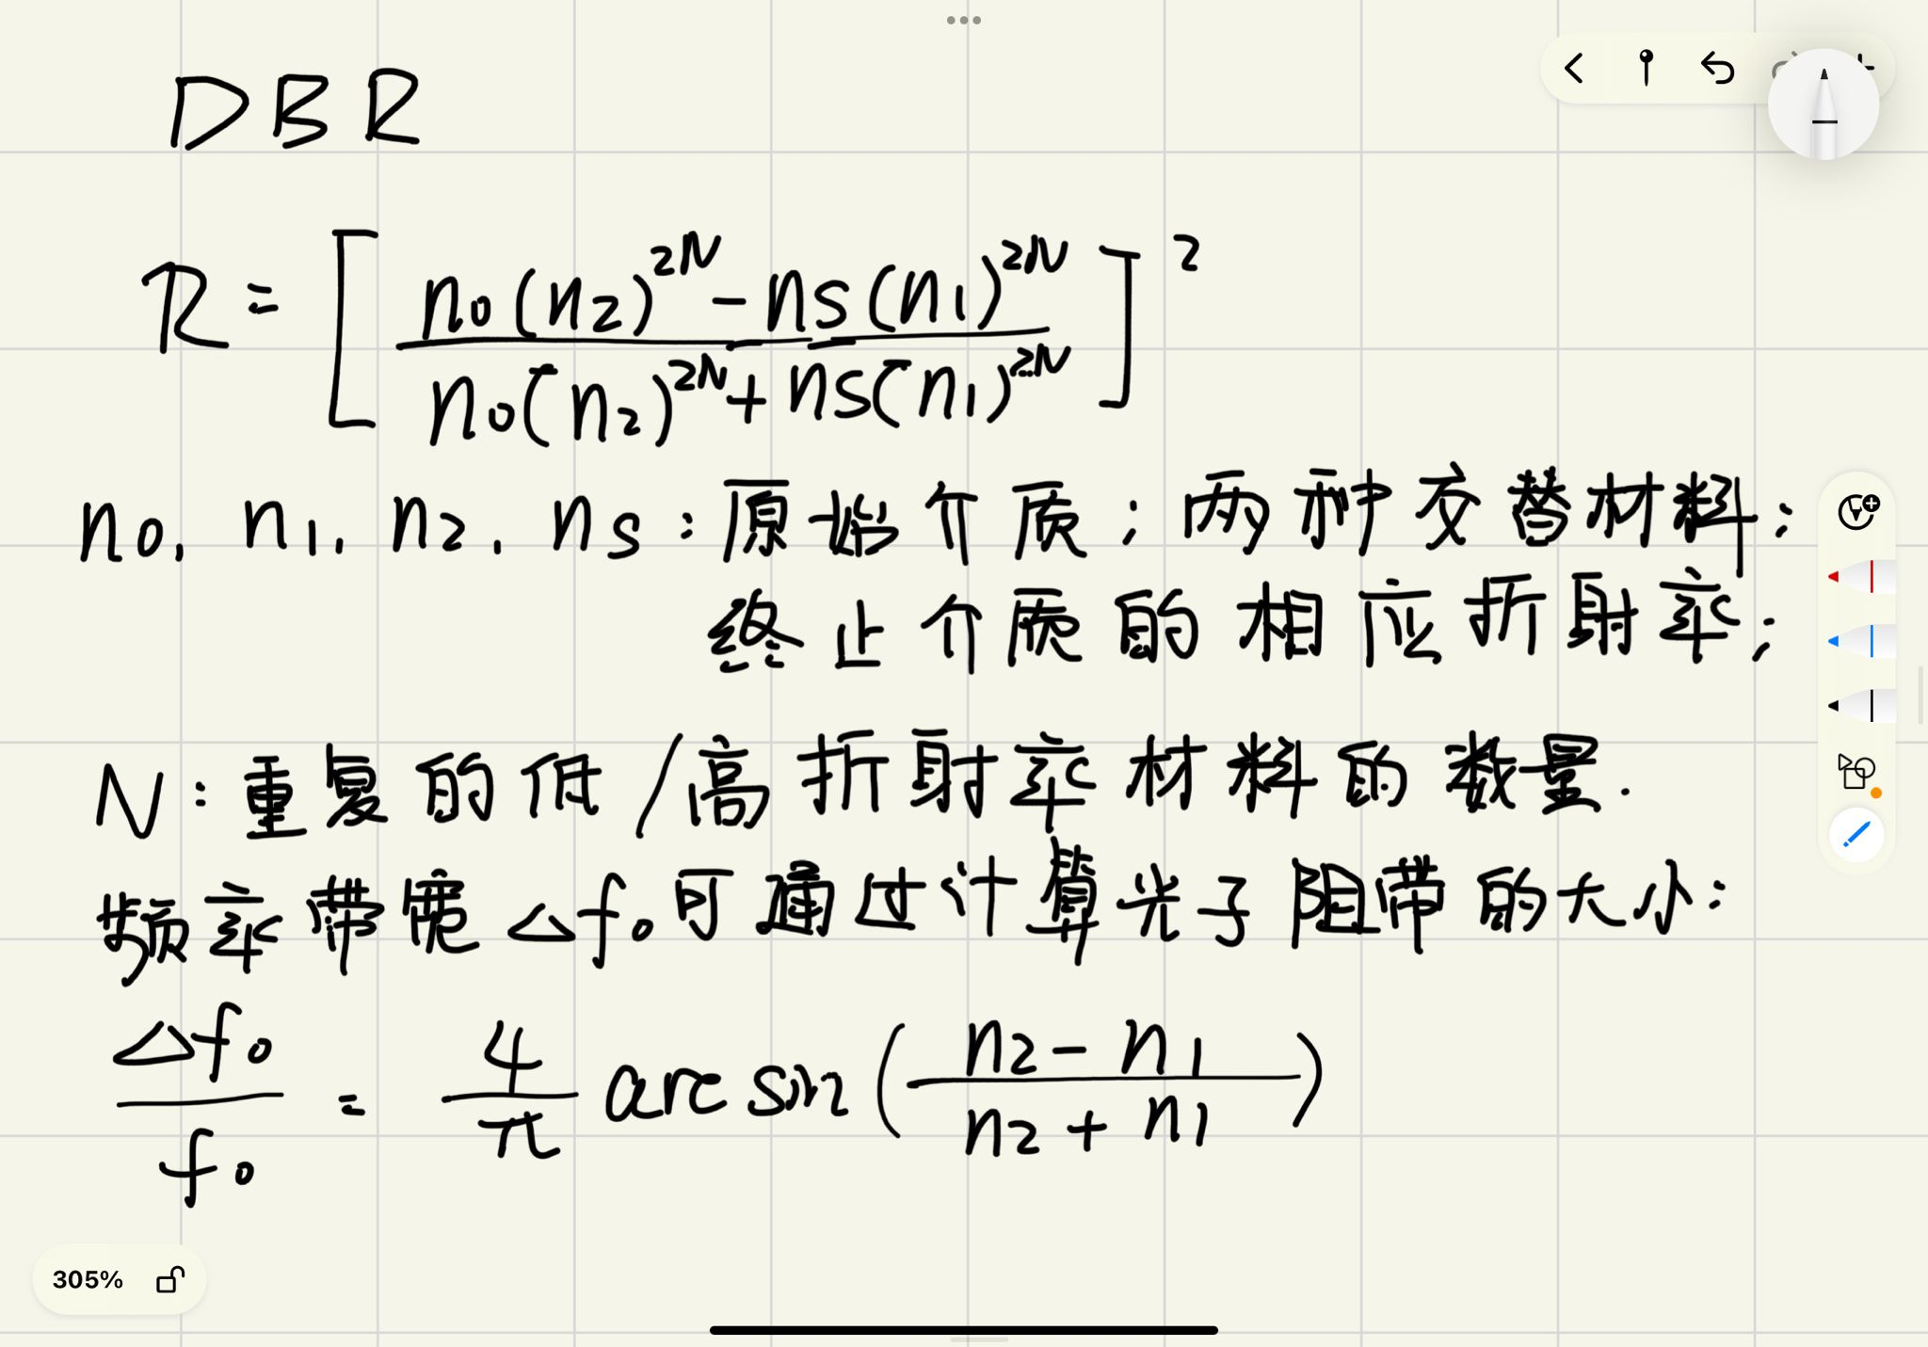
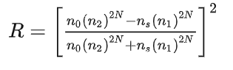
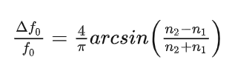
What’s the “DBR”?

Slide 11
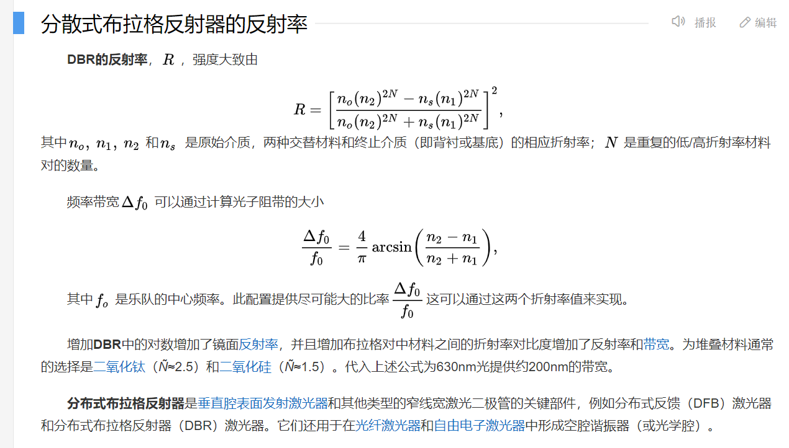
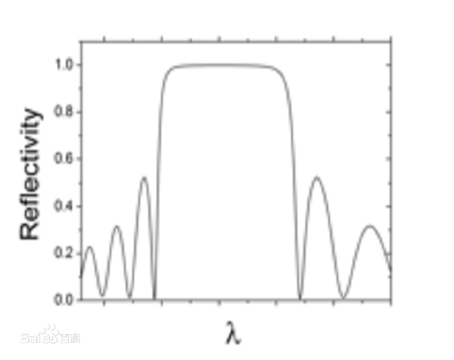
What’s the “DBR”?（appendix）

Slide 12
What’s the “DBR”?（appendix）
分布式布拉格反射器（distributed Bragg reflector，DBR）是在波导中使用的反射器。 当光经过不同介质时在界面的地方会反射，反射率的大小会与介质间折射率大小有关，因此如果我们把不同折射率的薄膜交互周期性的堆叠在一起，当光经过这些不同折射率的薄膜的时候，由于各层反射回来的光因相位角的改变而进行建设性干涉，然后互相结合再一起，得到强烈反射光。
如果多膜层数变的非常多，而薄膜折射率 n1、n2、n3…. 的差变得非常小时，光就如同在同一个介质里前进，反射系数变得非常小。由于光的多重干涉而造成干涉效果十分明显，因此对于波长的选择变非常敏锐，在使用类似光栅情形时，这样的周期性结构就被称为分布式布拉格反射器（Distributed Bragg reflectors）。
这种现象常运用在单反相机的镜头上，虽然对于理想状态下的镜片而言，光线能够完全透过镜头，并正确的在底片或CCD上完全聚焦。然而，事实上，任何物体都会对光线反射，即便是透明玻璃也是如此，所以为了增加光通量，我们常会在镜头上镀膜，于是利用分布式布拉格反射器，可以使光线在一定波长的范围内减少反射，增加通光量。

Slide 13

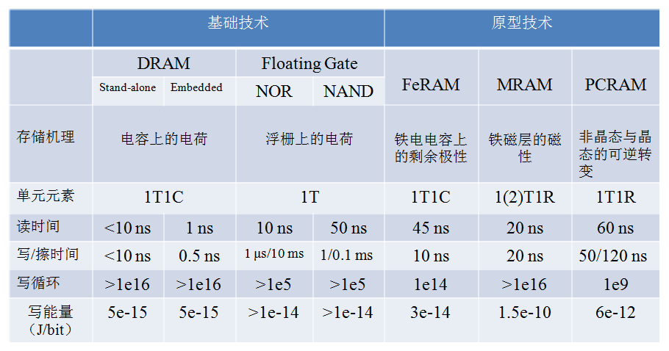
PCM——（Phase change materials/memory）
CD
Phase-change memory
0/1
Amorphous
Crystal

Slide 14
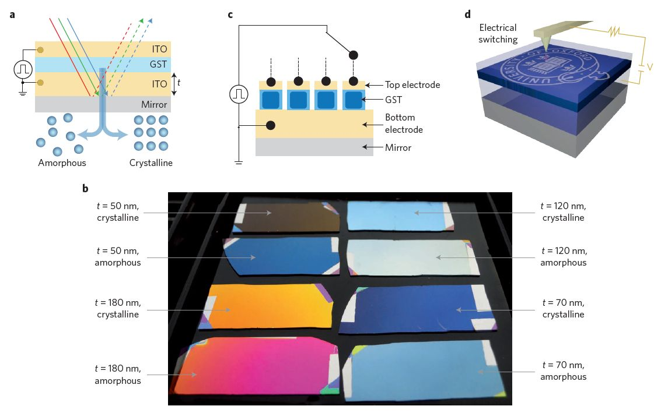
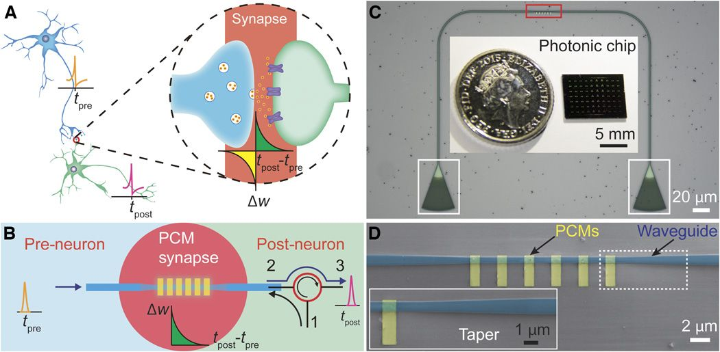
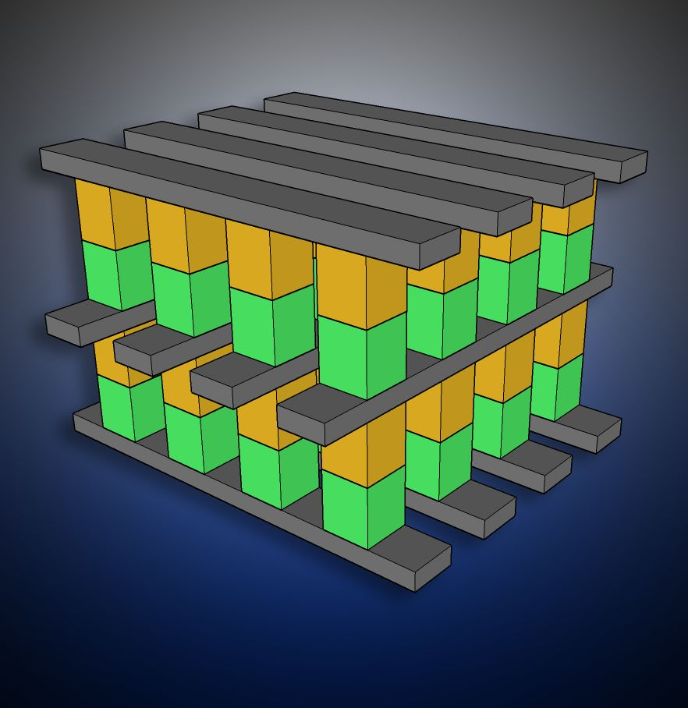
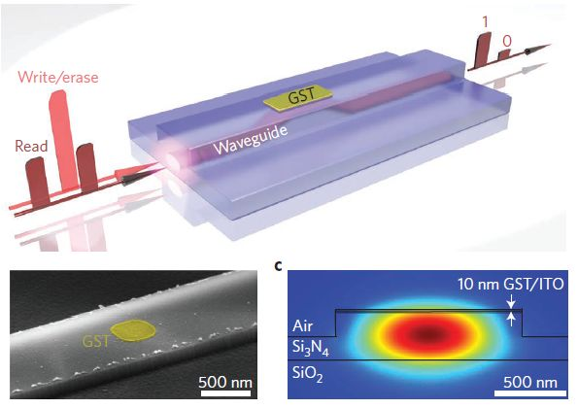
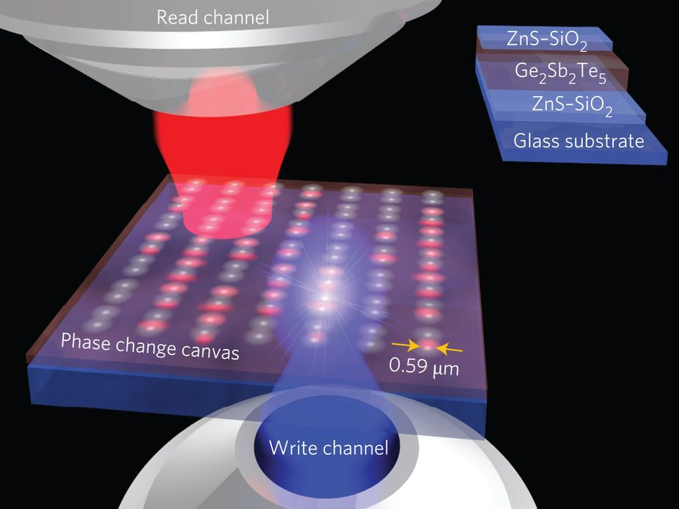
PCM——（Phase change materials）

Slide 15
Deep neural network enabled active metasurface embedded design
# Paper Abstract：
1. Provenance：Nanophotonics （IF : 7.923）
2. Author：
3. Cites：not very high（According to incomplete statistics）
Goals:
In this paper, based on deep learning, a forward modeling and back design for photonic devices embedded with active metasurface structures is proposed.

Slide 16
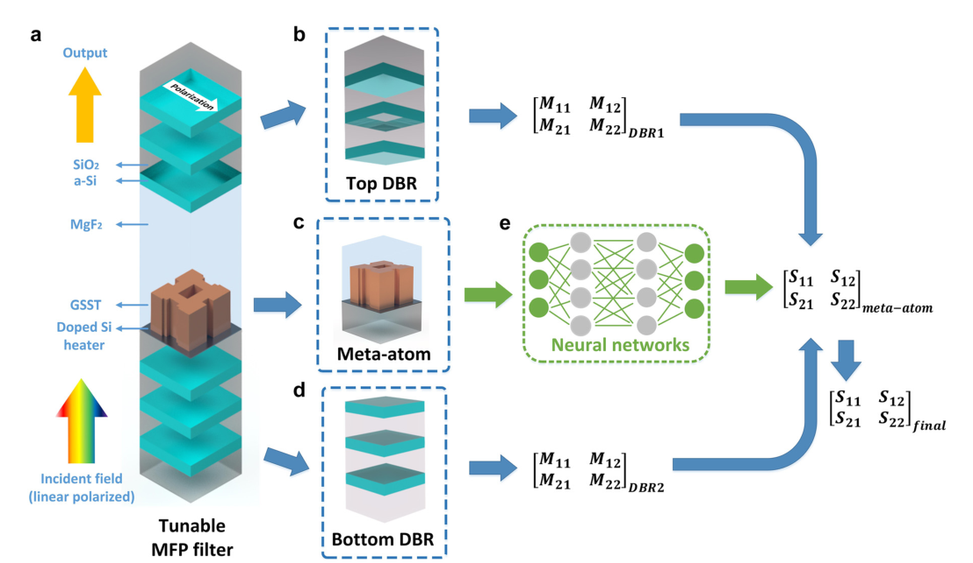
MFP filter conceptual graph
S matrix ： a description of scattering process and reaction process of microscopic particles
M matrix：DBR transfer matrix

Slide 17
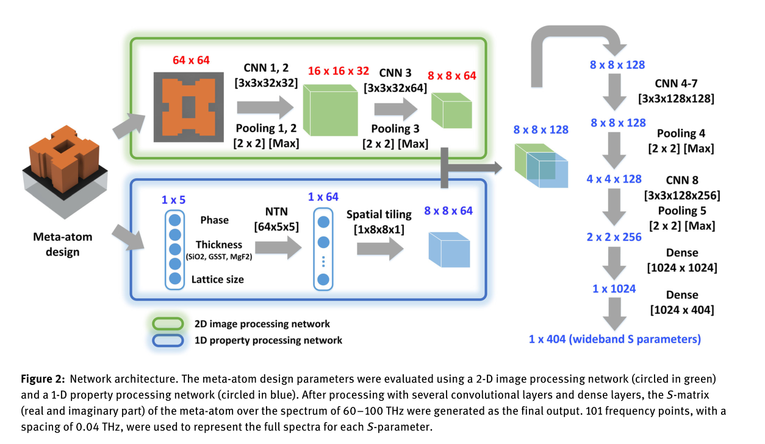
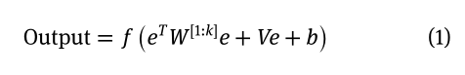
Forward prediction DNN
The NTN output is as follows:
needle drop for 105 picture

Slide 18
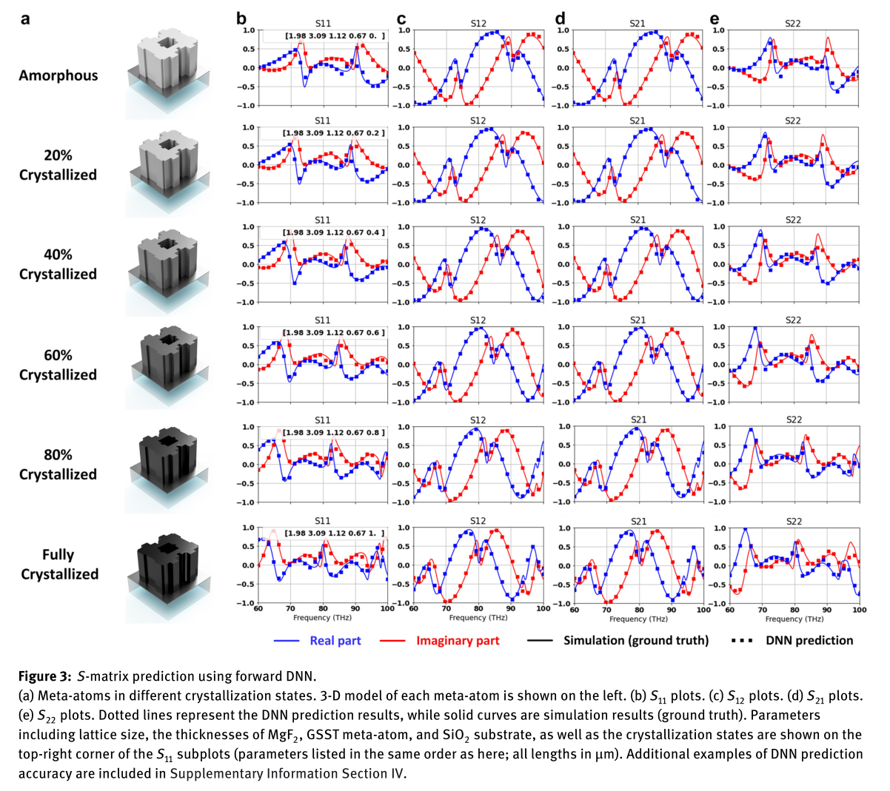
Forward prediction DNN

Slide 19
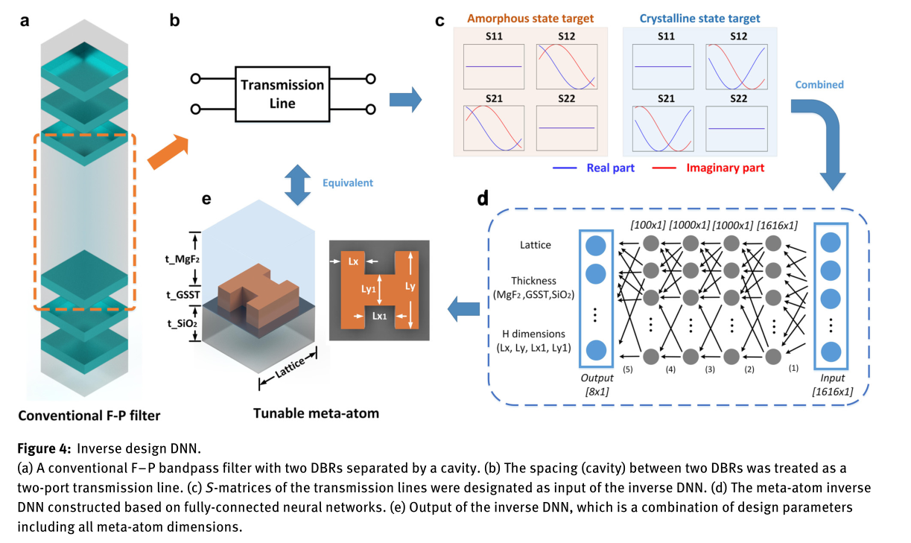
Inverse design DNN

Slide 20
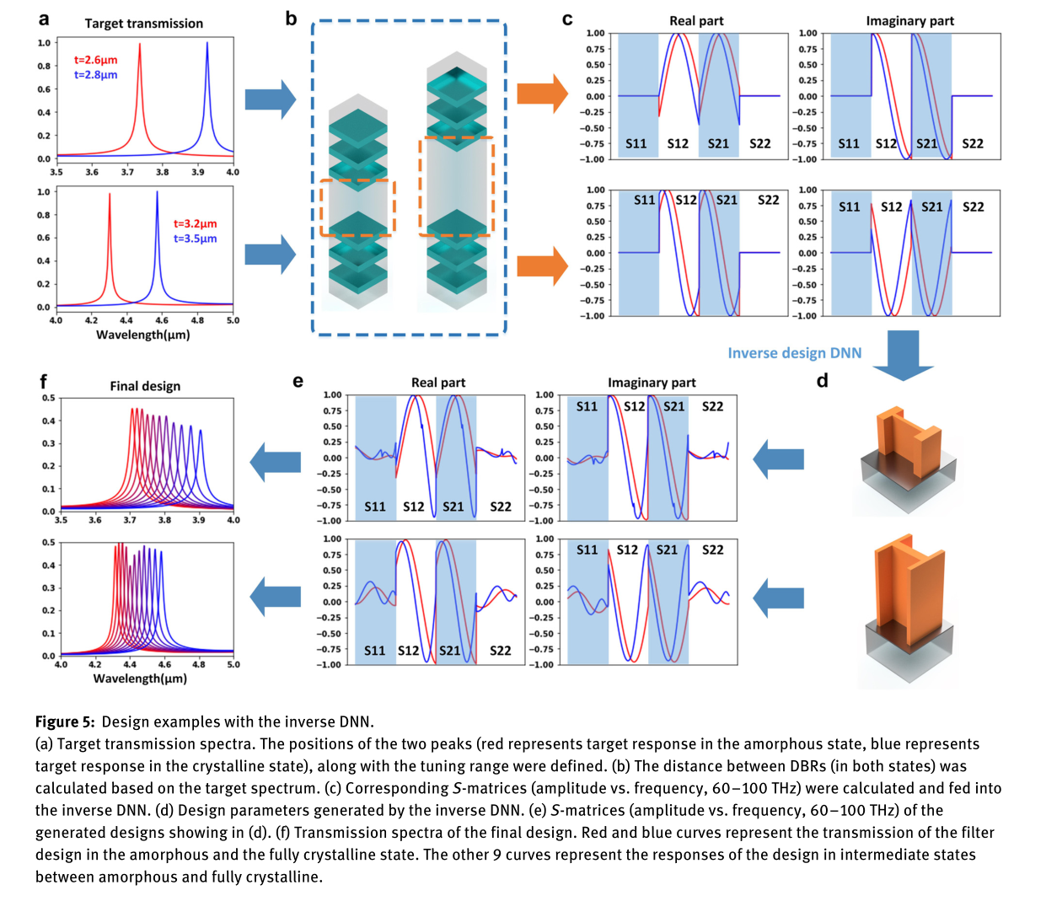
Design examples with the inverse DNN

Slide 21
Conclusions
Advantages：
1. develop a method for the design of complex photonic structures（DNN helps it to improve）
2. achieve computational efficiency and accurate reverse structural design
3. the hybrid design scheme can be extended to other photonic structures containing S-matrix described metasurface, such as waveguide devices, photonic crystals, and stacked multilayer metasurface.

Slide 22
Other researches around meta surface with DNN

